Slide 1
Lead Scoring Case Study
Introduction
Company Background: X Education sells online courses to industry professionals.
Marketing Channels: Google, websites, referrals.
Lead Acquisition: Forms, videos, referrals.
Conversion Rate: 30%

Slide 2
Business Goals
Objective: Identify "Hot Leads.
Model Requirement: Assign lead scores
indicating conversion probability.
CEO's Target: 80% conversion rate.

Slide 3
Overall Approach
Data Cleaning and Imputing Missing Values
Exploratory Data Analysis
Feature Scaling and Dummy Variable Creation
Logistic Regression Model Building
Model Evaluation
Conclusion and Recommendation

Slide 4
Data Cleaning and Preparation
Read data from source.
Clean and format data.
Remove duplicates.
Outlier treatment.
Perform EDA.

Slide 5
Data Conversion
Convert Yes/No values to 1/0.
Handle 'Select' values with NaNs.
Drop columns with >70% null values.
Remove unnecessary columns.
Drop rows with <2% null values.

Slide 6
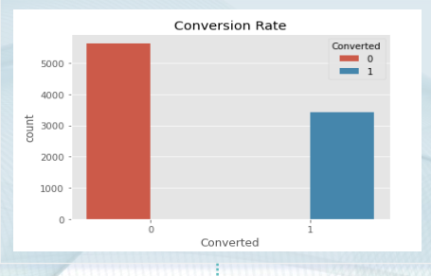
Exploratory Data Analysis (EDA)
Conversion rate: 30%.

Slide 7
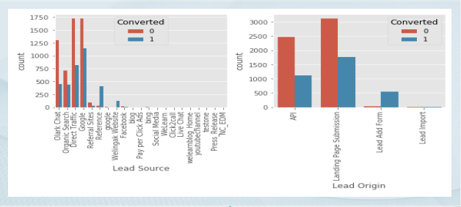
Maximum leads from Google and Direct Traffic.
Highest conversion rate from References and Welingak Website.
Low count but high conversion rate from Lead Add Form.

Slide 8
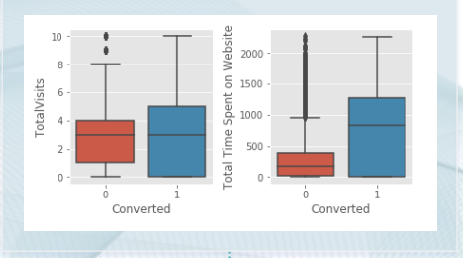
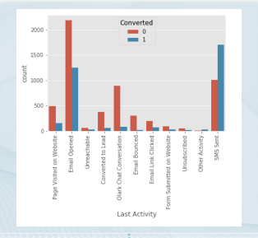
Users spending more time are likely to convert.
'Email Opened' has maximum lead activity.
Highest conversion rate for SMS sent as last activity.
No conclusive inference for Specialization.

Slide 9
Model Building
Split data into train (70%) and test (30%) sets.
Feature selection using RFE, VIF, and p-value.
Logistic Regression model building.
Test dataset predictions.
Achieved 92% accuracy.

Slide 10
Model Evaluation
Metrics:
Accuracy, Sensitivity, Specificity for various cutoffs (0.1 to 0.9).
Optimal cutoff: 0.27.
Train Data Confusion Matrix:
Accuracy: 83.59%
Precision: 71.6%
Sensitivity: 94.9%
Specificity: 76.5%

Slide 11
Conclusion
Summary:
Logistic regression model predicts conversion probability.
Model performance: 92% conversion rate on test data, 95% on train data.
Key contributing variables: Tags and Lead Quality.
Model aligns with business requirements and is adaptable for future needs.

